Slide 1





Community Nextgen and Infrastructure Advancements
NextGen Team at CIROH
Arpita Patel, James Halgren, Zach Wills, Nels Frazier, Benjamin Lee, Sepehr Karimi, Trupesh Patel, Josh Cunningham, Shahab Alam, Jordan Laser, Mike Johnson, Steven Burian, Purushotham Bangalore, Jeff Carver
November 28, 2023

Slide 2


NextGen In A Box (NGIAB)
NextGen In A Box Ready-to-run, containerized and cloud-friendly version of NextGen framework, packaged with scripts to help prepare data and get you modeling more quickly.
GitHub repo: GitHub: CIROH-UA/NGIAB-CloudInfra
Prior recorded training resources: docs.ciroh.org: NGIAB (from workshops on 'How to run NGIAB' during CIROHDevCon1 and Summer Institute 2023.)
NGIAB is soon to be built on the community version of the NextGen National Water Resources Modeling Framework
GitHub Repo: GitHub: CIROH-UA/ngen
Ngen supports CFE, PET, FORTRAN_BMI, SLoTH, topmodel, t-route
NGIAB is compatible with DMOD – NOAA/OWP’s framework for testing ngen updates and other similar HPC application tasks.
GitHub repo: GitHub: NOAA-OWP/DMOD
Documentation, examples, and news at CIROH DocuHub: docs.ciroh.org: NGIAB
Notes:
NextGen In A Box
It is a NextGen framework advancement where we have introduced a community version of National Water Model. It is a tool that provides containerized version of NextGen National Water Resources Modeling framework.
Using this a tool researchers can use his/her own input data for a particular watershed to run the particular model like CFE and generate output data on his/her local machine Mac or any cloud instance (tested on Linux OS).
For more details visit: https://docs.ciroh.org/docs/category/nextgen-in-a-box

Slide 3
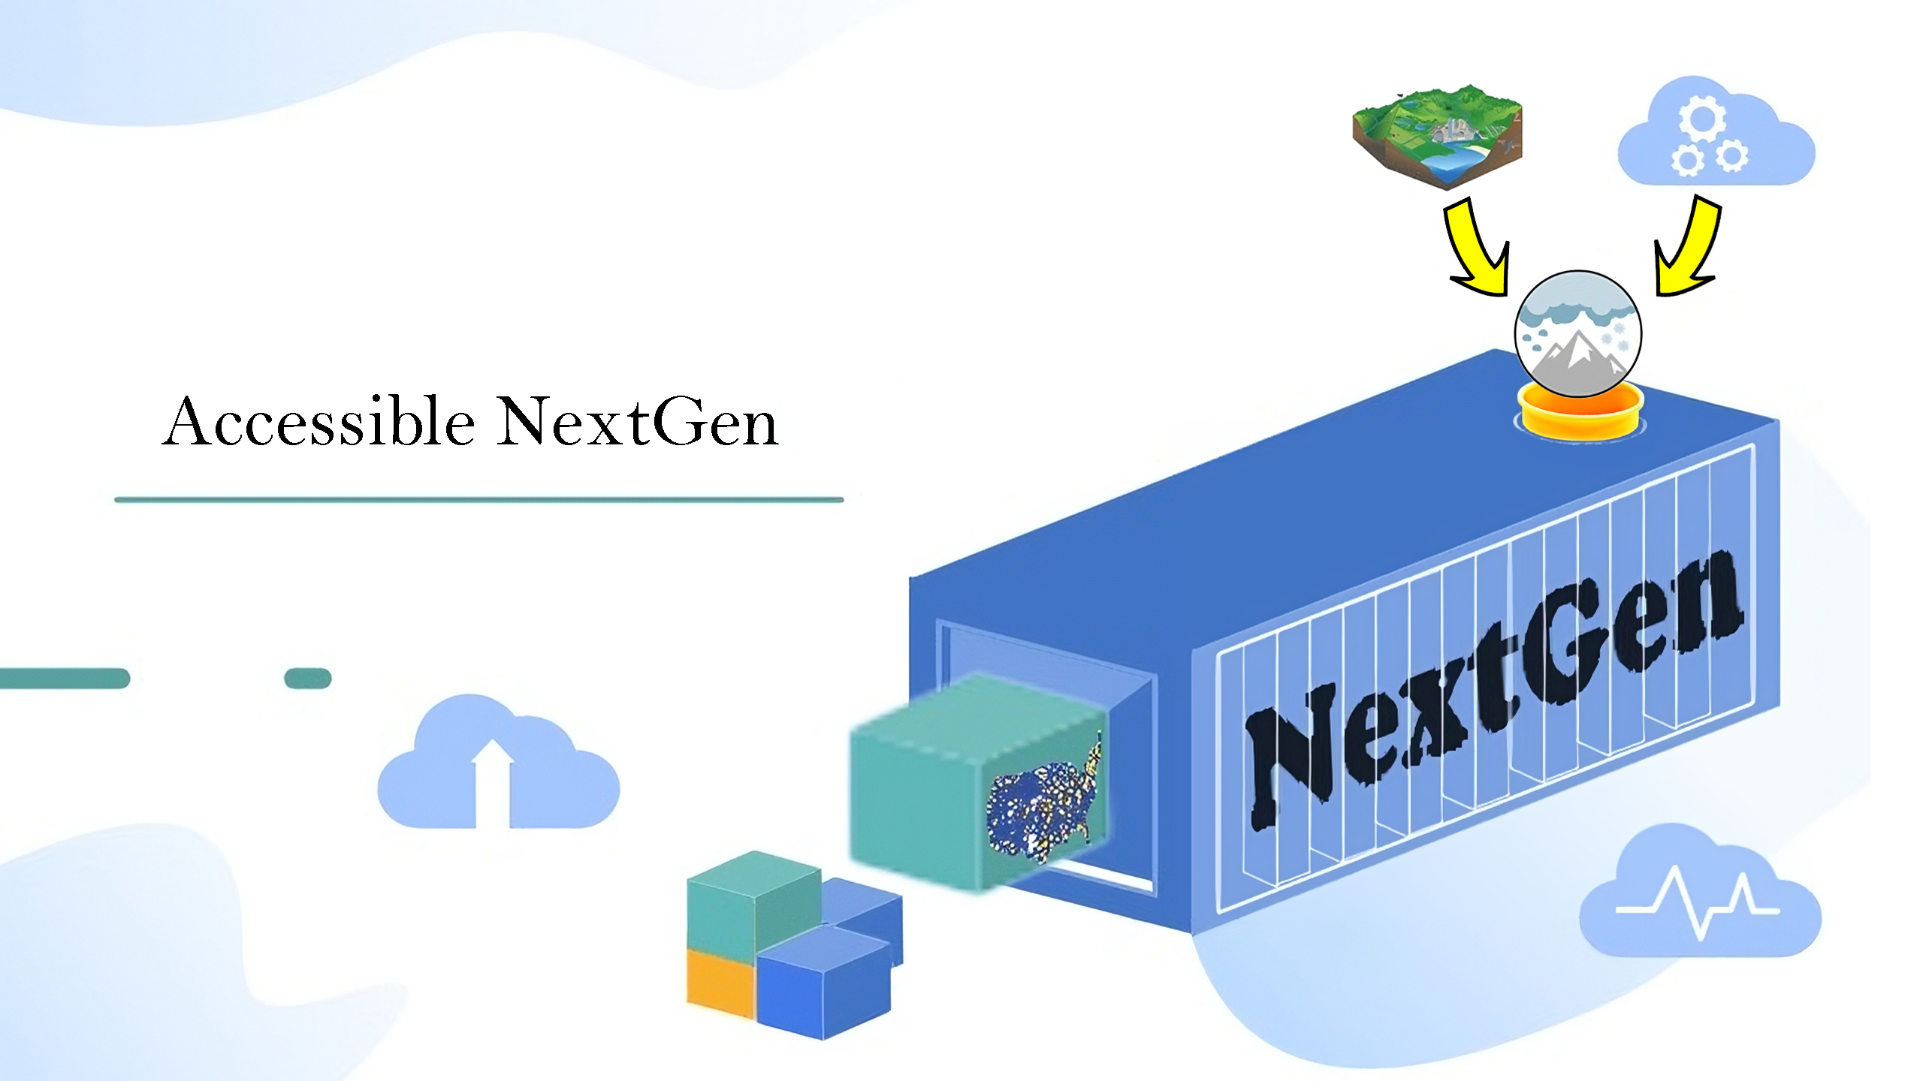
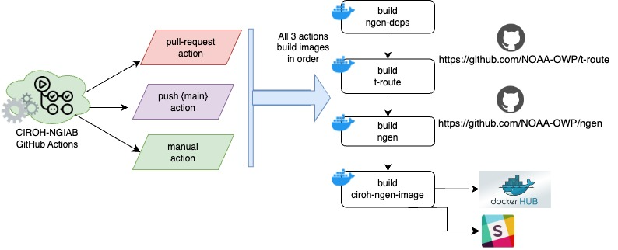
NextGen In A Box Key Progress
Template input data package:
S3 bucket at: CIROH data : AWI-002/AWI_03W_113060_002.tar.gz
NGIAB CI pipeline automatically building and deploying with updates.
T-Route package integration, build and test
Continuous data stream – in progress.
Revisions and refinements to “guide script” that walks user through NGIAB simulation execution.

Slide 4
Data Access Improvements
Kerchunk Zarr json headers
JSON Headers: Produced and uploaded for NWM output on an S3 bucket, optimizing data accessibility.
Access the Full Retrospective Zarr Dataset.
Explore the Full Operational Zarr Dataset.
Operational Zarr files are automatically generated and uploaded daily at 12:00 AM.
Developed to generate customized NWM output file URLs, facilitating seamless access.
Customize date range, forecast cycle, lead time, variable input, run input, and dataset for a tailored list of URLs.
Find the codebase on GitHub: CIROH-UA/nwmurl.
Install library: pip install nwmurl
Forcing preprocessor on GitHub: CIROH-UA/ngen-datastream
RTI-Teehr library extensions - docs.ciroh.org: RTI-Teehr
CUAHSI notebooks – GitHub: CUAHSI/notebooks
Data Access Demo Notebook (showing how these all work together) – in progress

Slide 5
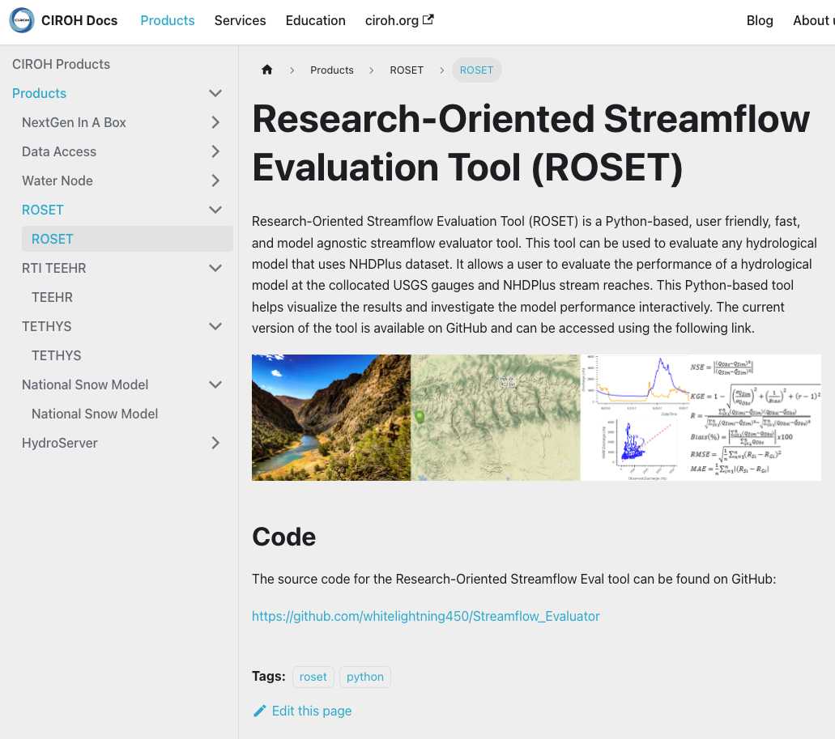
CIROH DocuHub
Community editable technical documentation hub - Collaborate now! at docs.ciroh.org
NextGen Resources
Data Access: docs.ciroh.org: data-access
CIROH Products: docs.ciroh.org: products
CIROH Services: docs.ciroh.org: services
News and Updates: docs.ciroh.org: blog
Other documented resources
BYU, USU, RTI, UA, OWP WaterNode
Integrating with portal.ciroh.org
Submit your PR now!

Slide 6

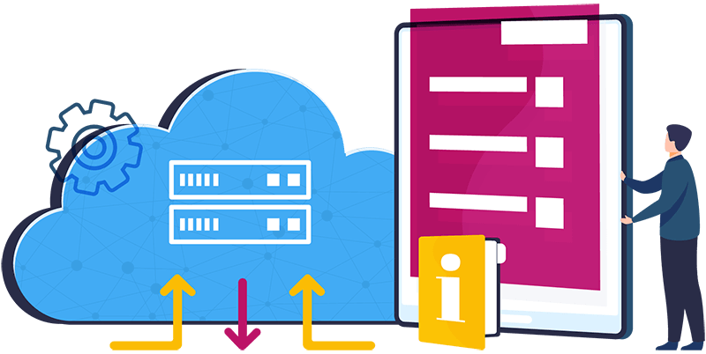
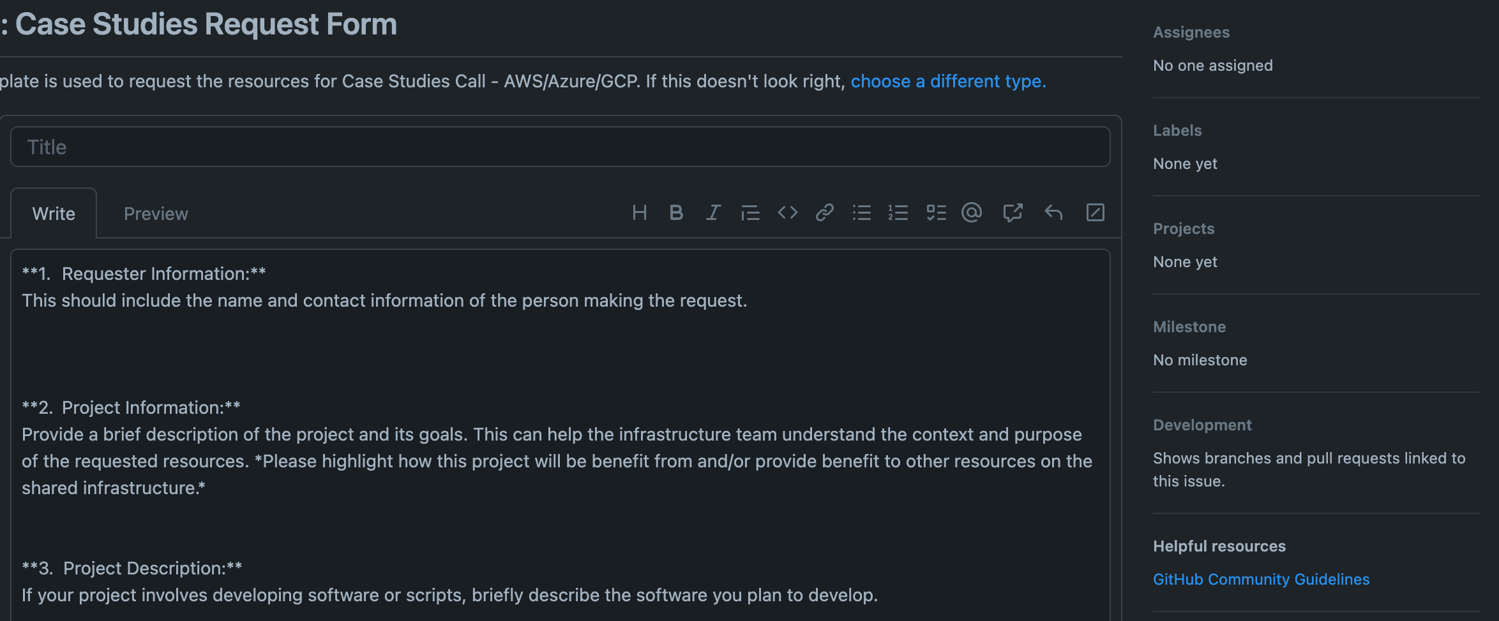

CIROH Cloud (2023 P29)
CIROHCloud - 2i2c Jupyterhub (Google) and AWS services
New! On-Premise VMs and ML HPC
Submit Request
Infrastructure : GitHub: CIROH-UA/NGIAB-CloudInfra/Infrastructure
OnPremise : GitHub: CIROH-UA/NGIAB-CloudInfra/OnPremise

Slide 7
Contact Us
Support Team
Join us on CIROH Slack
Channel - CIROH Slack: #nextgen_help_2023
Email : ciroh-it-admin
Thank You !

